Slide 1
Class of 2024
C-House 101

Slide 2
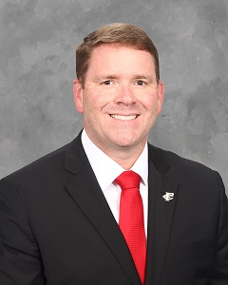
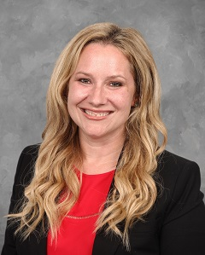
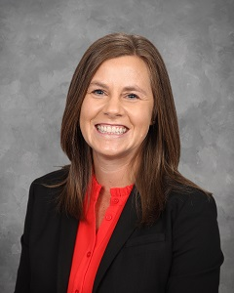
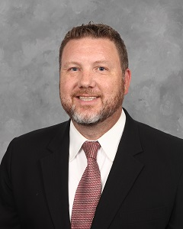
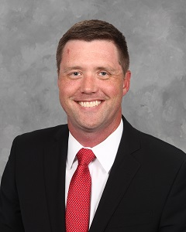
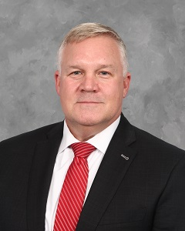
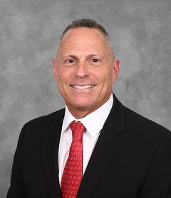
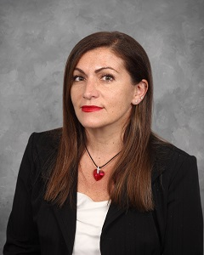
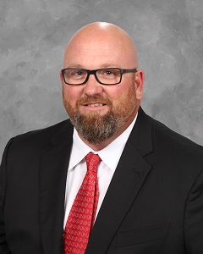
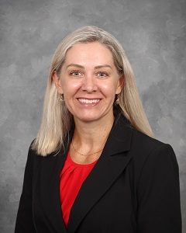
Meet Your Administration Team
Dr. Josh Lowe Principal
Lisa Oswald
Jimmy Pagel
Jonathan Schreier
Chris Woodall
Allyson Carvell
Dan Kaplan
Antonia Parisi
Brian Bradley
Jenny Gilmore

Slide 3
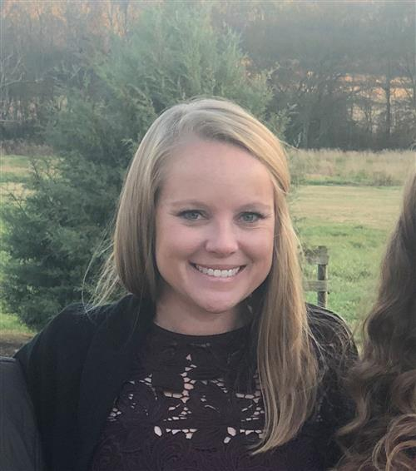
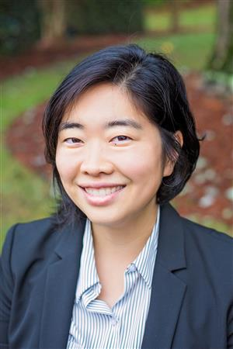
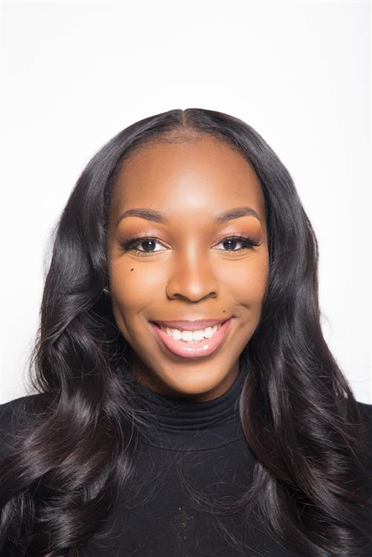
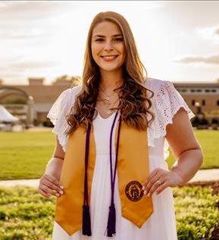
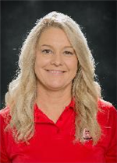
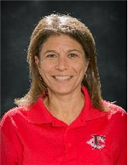
Meet Your Counseling Team
Courtney Knight
A-Cro
Jennifer Yoo
Cru-Fer & ESOL
Victoria Adeleke
Fet-Kn
Emily Dempsey
Ko-Martin &
T-Z
Leslie Flath
Martinez-Q
Andrea Katz
Lead Counselor
R-S

Slide 4
We are Here to Help You!
Counseling Services Offered:
Classroom Lessons for all students
Academic Advisement
Social, Emotional, and Academic support
Parent, Teacher, and Student conference coordination
Referrals to local therapists/resources
College and Career advisement and support
Dual Enrollment Information

Slide 5
High School Graduation Requirements
4 Credits of English
4 Credits of Math
4 Credits of Science
3 Credits of Social Studies
1 Unit of Physical Education/Health = .5 Health, .5 Personal Fitness
3 Credits of CTAE and/or World Language and/or Fine Arts
4 Additional Electives

Slide 6
4 English Credits
9th Grade Lit , 9th Grade Lit Honors
10th Grade Lit, 10th Grade Lit Honors
American Lit, AP American Lit/Lang
Advanced Composition, AP Lit, or Dramatic Writing
This Photo by Unknown Author is licensed under CC BY

Slide 7
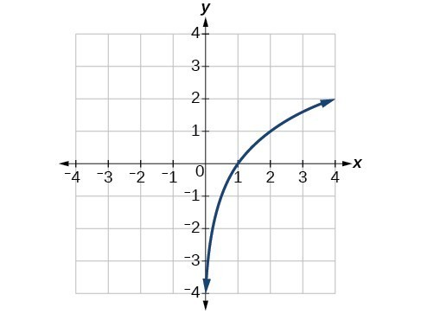
Math Credits
4 sequential math credits are required.
On level
Honors
Accelerated
AP
Ex - Algebra I, Geometry, Algebra II, 4th math senior year

Slide 8
4 Science Credits
Required:
Physical Science or Physics
Biology, Biology Honors
Earth Systems, Environmental Science or Chemistry
4th Science

Slide 9
Social Studies
9th grade options:
World Geography/Current Issues
Human Geography
10-12th grade courses:
World History or AP World History– 10th grade
US History or AP US History – 11th grade
Economics & American Government or AP Macro and/or AP Government

Slide 10
World Language
All University System of Georgia 4-year colleges and most private colleges require 2 consecutive years of the same World Language for admission.
FCHS World Language offerings
American Sign Language
German
Spanish
Native Speaker Spanish

Slide 11
CTAE Pathways
Automotive Technology
A/V Tech and Film
Cloud Computing
Computer Science
Cosmetology
Film Production
Marketing and Management
Marketing Communications
Sports and Entertainment Marketing
Nutrition and Food
Teaching as a Profession
Veterinary Science
Workforce Ready
Engineering

Slide 12
Fine Art Courses
Visual Arts
Media Arts
Band, Chorus, Orchestra
Tech Theatre
Theatre Acting

Slide 13
Balance and Rigor
Schedule
Course load: On level, Honors, AP, Dual Enrollment
Dual Enrollment/FVA/GAVS (Spring Deadline)
Extra-curricular
Work
Community Service

Slide 14
GPA
Forsyth Central GPA:
All Classes taken 9th-12th are factored into GPA
AP/Dual Enrollment full quality point given
Pay attention to the credit awarded for the class
1.0 yearlong courses
.5 semester long courses
Weight for On Level/Honors A=4.0 B=3.0 C=2.0 F=0 | Weight for AP/Dual Enrollment A=5.0 B=4.0 C=3.0 F=0

Slide 15
GPA continued...
HOPE/Zell Miller GPA
Only core classes taken 9th-12th are included in the GPA
Math, Science, Language Arts, Social Science, World Language, most AP courses
AP/Dual Enrollment courses awarded .5 quality point with nothing above a 4.0
Pay attention to the credit awarded for the class
1.0 yearlong courses
.5 semester long courses
Weight for On Level/Honors A=4.0 B=3.0 C=2.0 F=0 | Weights for AP/Dual Enrollment A=4.0 B=3.5 C=2.5 F=0
Check out the unofficial GPA calculator that can be found on the counseling webpage at: https://www.forsyth.k12.ga.us/Page/21799

Slide 16
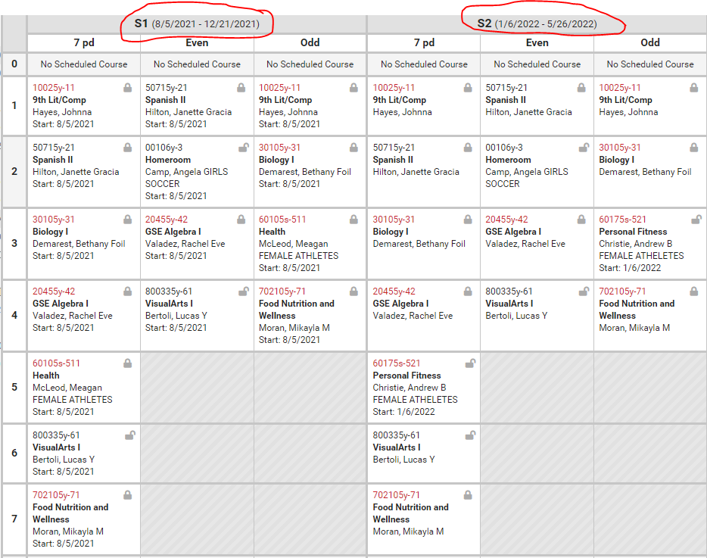
Sample schedule

Slide 17
College and Career Center
Assistance with Post-Secondary Planning
Scholarships
College Applications
Military Exploration
Career Exploration
College Rep Visits
Essay Assistance
Register for SAT/ACT

Slide 18
C – House Student Supports
Graduation Coach – Student Success through the years
School Social Worker – Assistance for our families and students
School Nurse – Caring for the health and well-being of students
Student Advocacy Specialist – offers SEL support to students
“The Well” (dedicated space w/dedicated Wellness Coach) supporting our students with movement, mindfulness, relaxation, stress reduction and other services
Power Hour – chat with friends or attend tutoring with teachers
Homeroom – academic support, clubs and activities

Slide 19
Get Connected
Over 50 Clubs!
Athletics
Band
Theater & Arts
Join FCAB
Club Fair: August 29th during lunch/power hour
Please visit our FCHS webpage under Extracurricular for more information.

Slide 20
Please visit our Counseling Website
And our Social Media accounts
for Counseling news!
Facebook: FCHS Counseling
Instagram: fchsbulldogcounseling
Twitter: @FCHCounseling ​

